Slide 1
Womanium Global Quantum +Ai program 2024 Final Project Presentation Deck Chosen Topic: Quantum Machine Learning for Conspicuity Detection in Production

Slide 2
TEAM DETAILS
Womanium Quantum +Ai project 2024
Member 1: Pranav VB

Slide 3
PROBLEM STATEMENT
Womanium Quantum +Ai project 2024
The Quantum Machine Learning for Conspicuity Detection in Production project aims to leverage the power of quantum computing to enhance the detection of conspicuous features in manufacturing environments. By integrating quantum machine learning algorithms with classical ML techniques, this project seeks to improve the accuracy and efficiency of identifying defects, anomalies, or other significant features in production lines. The quantum approach offers the potential for faster processing and better handling of complex data patterns, ultimately leading to more reliable and robust quality control in manufacturing processes.
This project covers 5 subtasks as part of Womanium Quantum +Ai project.

Slide 4
Project solution
Womanium Quantum +Ai project 2024
Focusing on task 4, solution to learning a sine function involved developing variations of the QML circuit models and increasing depth and number of qubits for each iteration.
Learning a sine function within the range 0 to 2π involved using a quantum neural network (QNN) to approximate the sine wave. The QNN is trained by encoding the input values (angles) into quantum states, applying parameterized quantum circuits, and then measuring the output. The goal is to adjust the parameters of the quantum circuit to minimize the difference between the predicted outputs and the true sine values. This process leverages quantum computing's potential for handling complex function approximations and could demonstrate how quantum models can learn periodic functions efficiently.

Slide 5
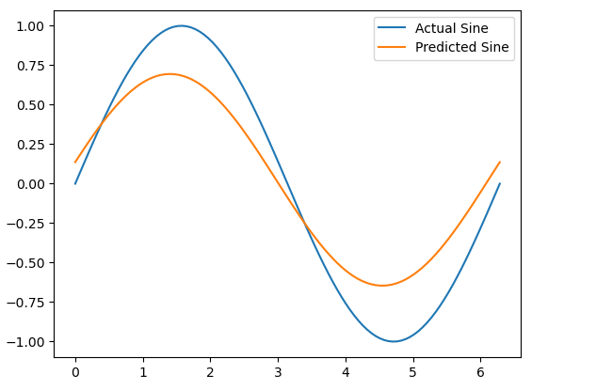
Success
Womanium Quantum +Ai project 2024
The result shows improved performance of our quantum machine learning model for approximating the sine function. The predicted sine function is closer to actual sine function.
The loss was reduced to 0.06.

Slide 6
Future scope
Womanium Quantum +Ai project 2024
1. Increasing Model Complexity:
Recommendation: Experiment with more complex quantum circuits, such as deeper layers or circuits with more qubits, to better capture intricate patterns and improve accuracy.
Current Limitation: Limited qubit count and noise in available quantum hardware may restrict the complexity of circuits that can be efficiently trained
.
2. Hybrid Quantum-Classical Models:
Recommendation: Integrate classical neural networks with quantum circuits to create hybrid models that can leverage the strengths of both quantum and classical computing.
Current Limitation: Developing efficient hybrid architectures requires more research.
3. Real-World Data Applications:
Recommendation: Apply the QML approach to real-world time series data, such as stock prices or weather patterns, to assess its practical applicability.
Current Limitation: Access to high-quality, real-world quantum data and the computational resources needed to process such data may be limited.

